Slide 1
BRIDGING THE FOOD GAP IN Food CONNECT using mobile app
TEAM MEMBERS
513320106002 – ARULANANTHAM E
GUIDED BY, 513320106005 – BARATHVAJ T
DR.R.EZHILARASI ME,Ph.D 513320106030 – NITHISHKUMAR M
Assistant prof & HOD(ECE) 513320106307 – THENU M

Slide 2
ABSTRACT
In response to the pressing issue of food waste and the simultaneous challenge of ensuring access to nutritious meals for those in need, this project introduces a Waste Food Collection and Delivery App
This innovative solution leverages mobile technology to connect food donors with surplus edibles to recipients in need.
The app streamlines the process of collecting excess food from various sources and orchestrates efficient deliveries to organizations or individuals requiring assistance.
Through this initiative, we aim to bridge the gap between surplus food and hunger, contributing to a more sustainable and socially responsible food distribution ecosystem.

Slide 3
INTRODUCTION
Our innovative food waste management system, available as an Android application, offers a solution.
Designed to connect restaurants and hotels with leftover food to NGOs dedicated to combating hunger, this food donation app ensures that excess food finds its way to those in need rather than ending up in landfills.
NGO Requests: NGOs can raise a request for excess food through the app.
Restaurant Approval: Participating restaurants receive these requests and can approve them based on their leftover food availability.
Food Collection: Once approved, NGOs can collect the food for distribution among the needy
Racking and History: The system maintains a record of all transactions, allowing for transparency and accountability.

Slide 4
LITERATURE REVIEW
S. No | Published Year | Topic | Publication | Content
1. | 2023 | Digital innovation in the food industry | Digital Food : The Future of innovation in the food industry by David Lipton | Explores how technology is impacting food production, supply chains, and consumer behavior.
2. | 2022 | Bridging the Digital Divide in Rural Communities | The Big Disconnect: Bridging the Digital Divide in Rural America by Christopher Alix et al. | Examines the digital divide in rural areas and potential solutions, relevant to rural food systems.
3. | 2020 | Food System and Policy Frameworks | Food Sustainability: The missing policies by David Harvey | Critically analyzes food systems and policies, suggesting approaches for more sustainable and equitable systems.

Slide 5
EXISTING SYSTEM
1. Traditional Food Distribution Systems:
The prevailing food distribution systems often face challenges related to inefficiencies, lack of transparency, and limited accessibility. Traditional models may contribute to the existing food gap due to their inability to adapt to evolving demands and technological advancements.
2. Online Food Platforms:
'Aahar’ is a Mobile phone Android program that gives donors and NGOs with a assembly to donate and collect food once they have successfully logged into the system.
3. Olio:
Olio is a food-sharing app that connects businesses and individuals with surplus food to nearby users who can benefit from it. The app's primary goal is to reduce food waste by redistributing excess food within local communities.
4. Share the meal:
The "Share The Meal" app is a humanitarian initiative developed by the United Nations World Food Programme (WFP). The app allows users to make small, digital donations to provide meals for children in need around the world.

Slide 6
PROPOSED SYSTEM
In response to the identified shortcomings in existing systems, our project introduces a dynamic and comprehensive solution within the Food Connect framework.
In our waste food collection and delivery app "Karna“, we implementing features like real-time food donation tracking, a user-friendly interface for both donors and recipients, and partnerships with local NGOs or shelters for efficient distribution.
Additionally, incorporate a rating system to encourage reliable donations and ensure the quality of delivered food.
Regularly update users on the impact of their contributions and explore gamification elements to boost user engagement and participation.
These platforms facilitate direct communication between producers and consumers, fostering a sense of community and promoting

Slide 7
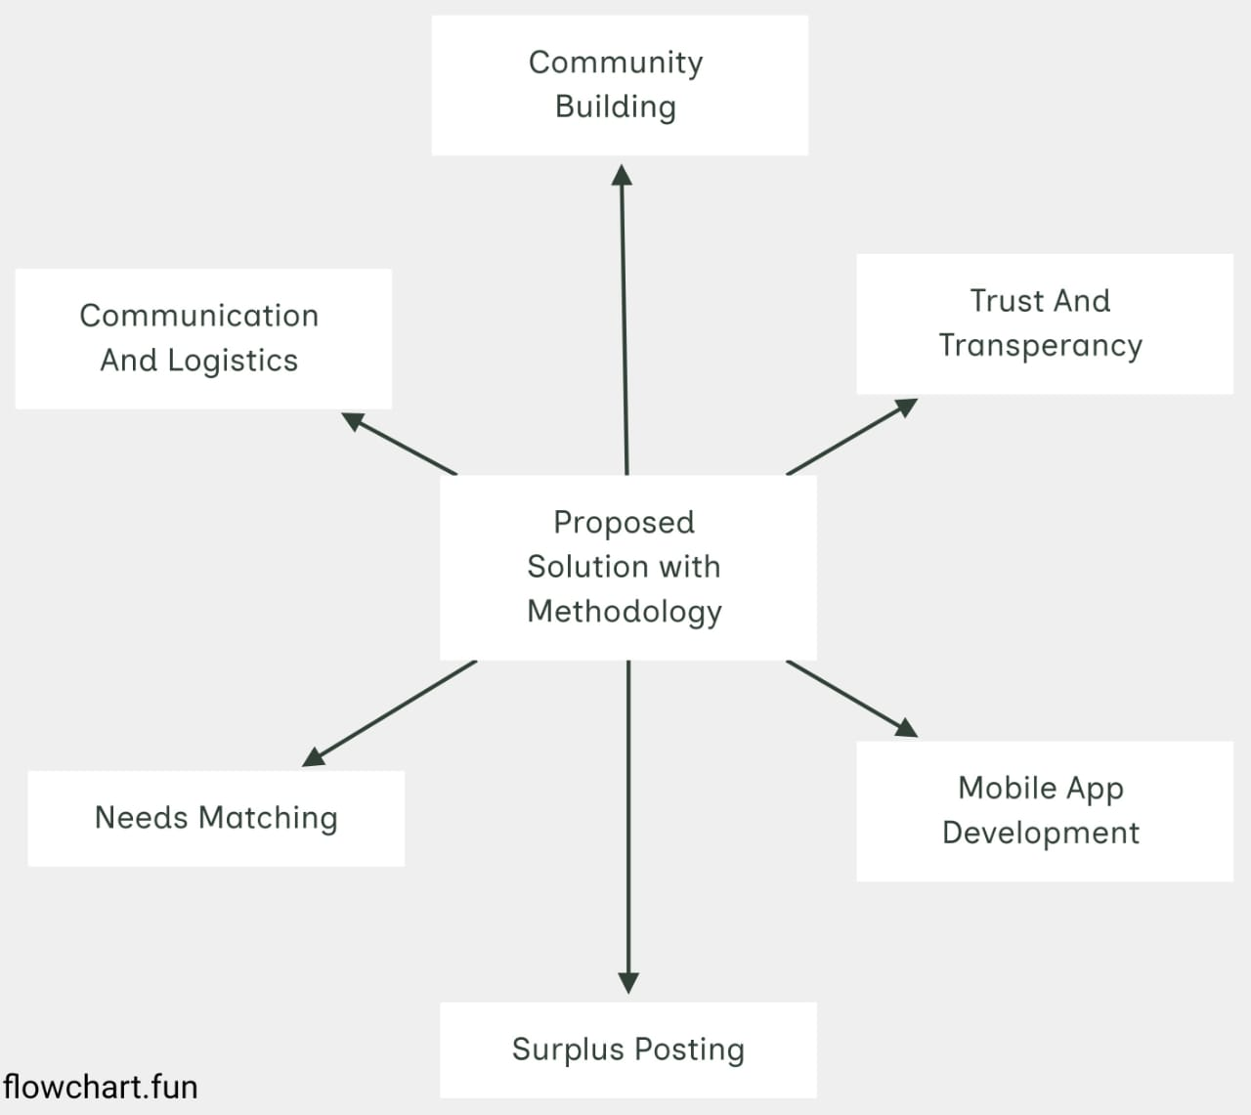
PROPOSED METHODOLOGY

Slide 8
TECHSTACK:
Frontend: React native (App development both android , ios),
Backend : Express js, mongodb, node js .
Desiging : Figma.

Slide 9
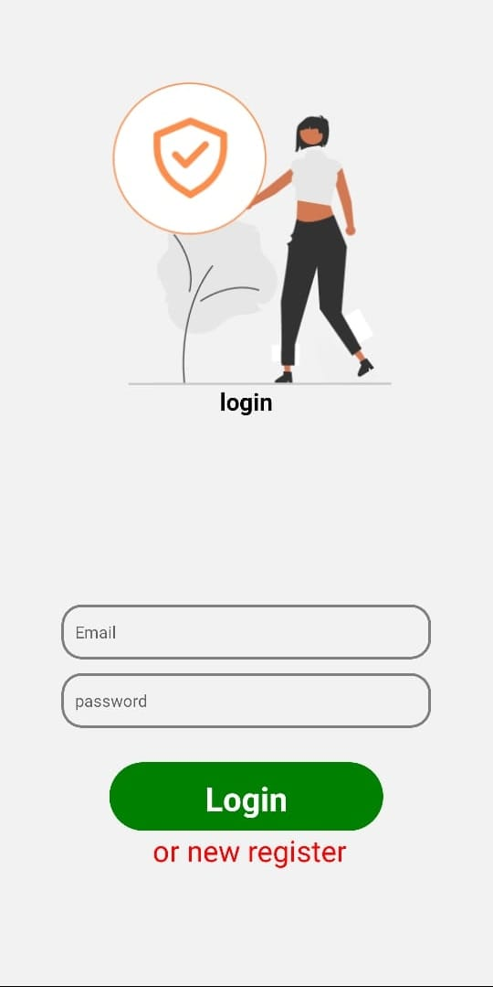
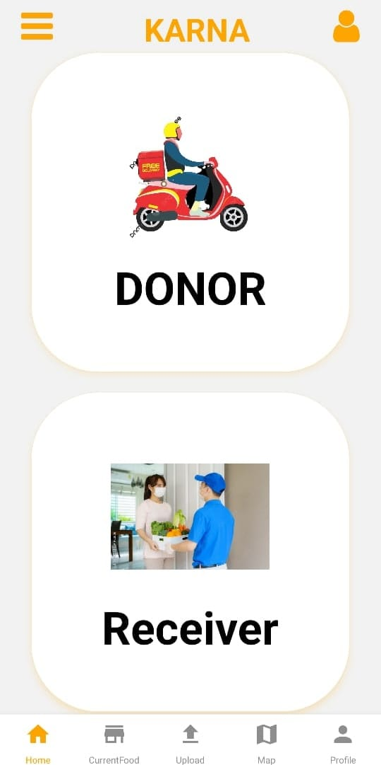
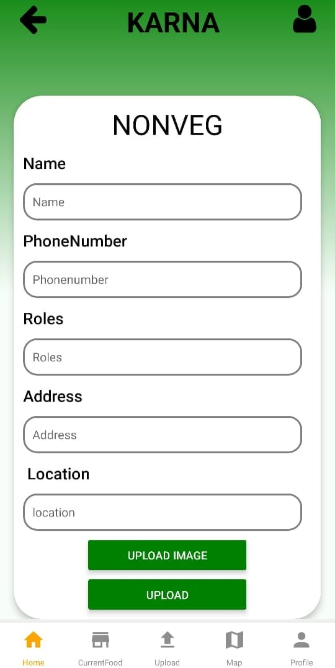
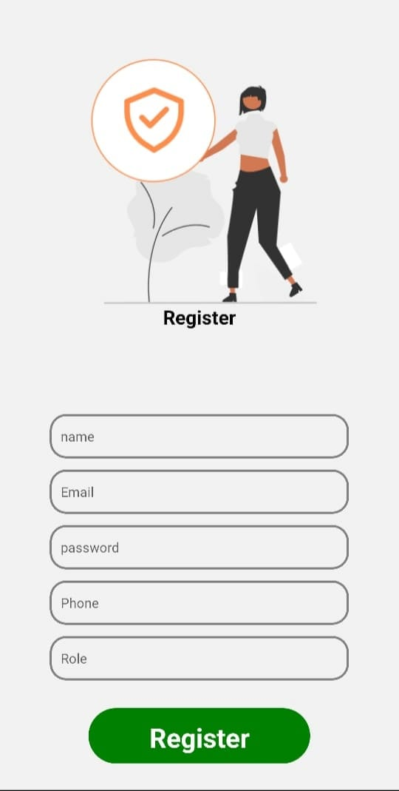
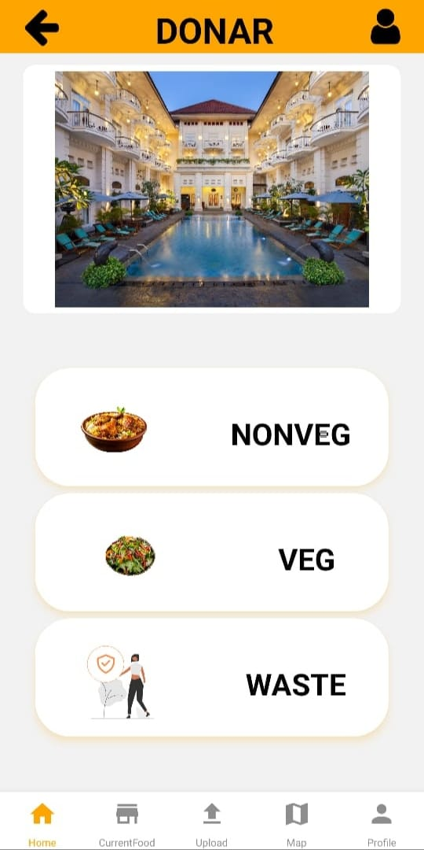
App Design:

Slide 10
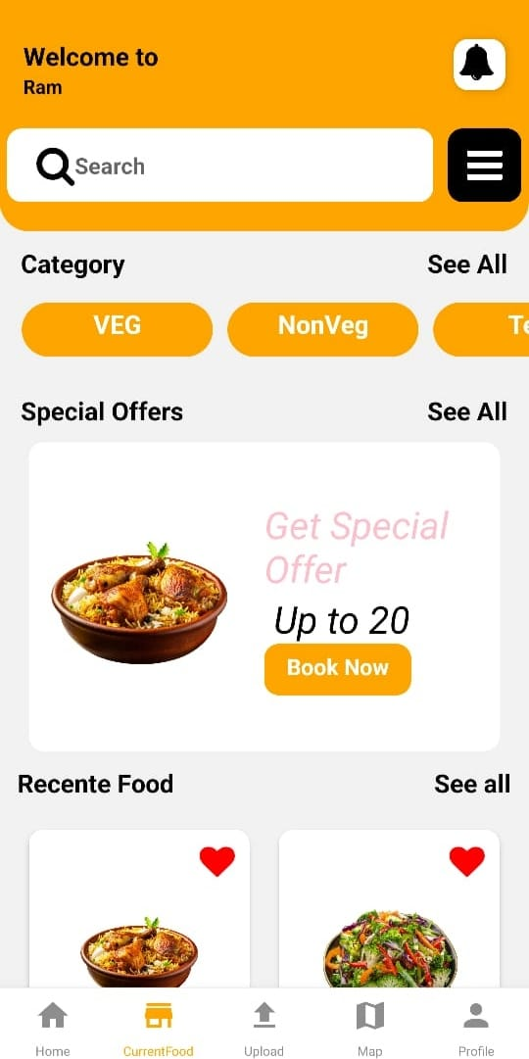
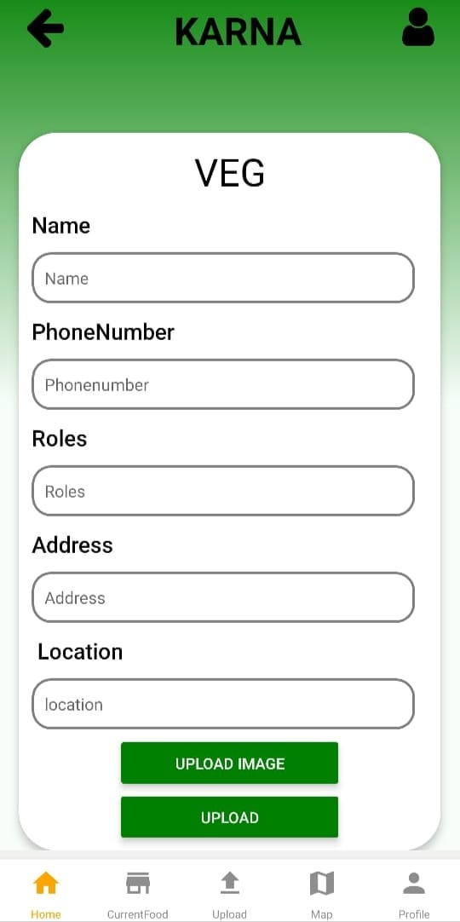
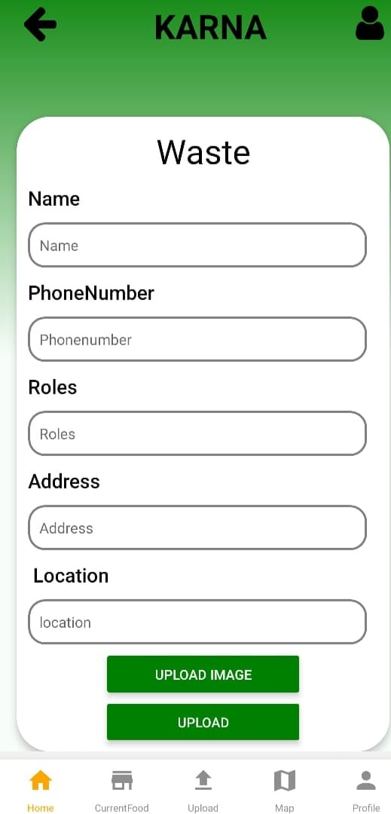

Slide 11
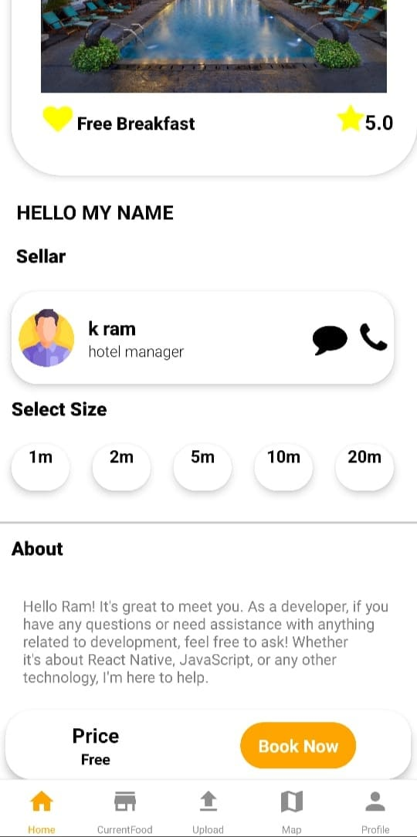
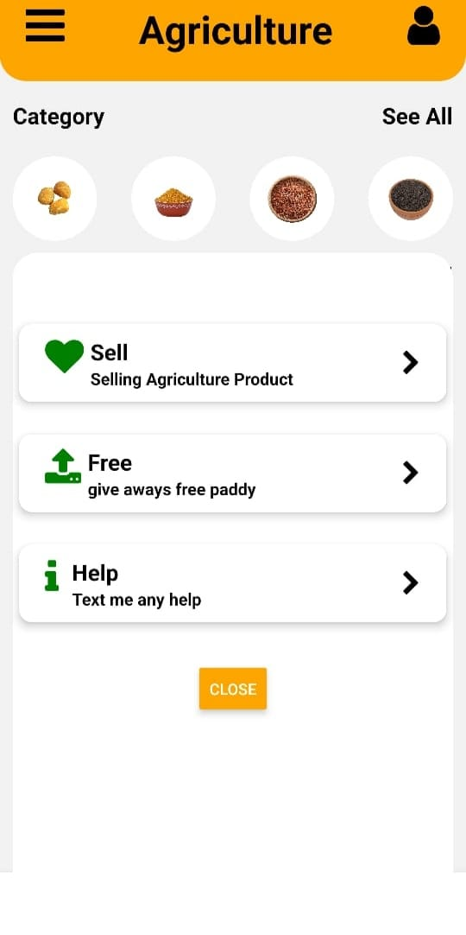
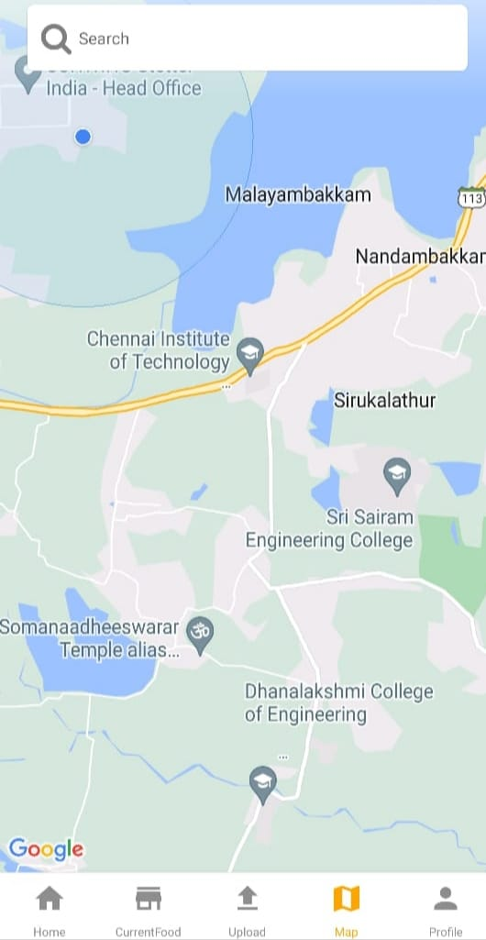
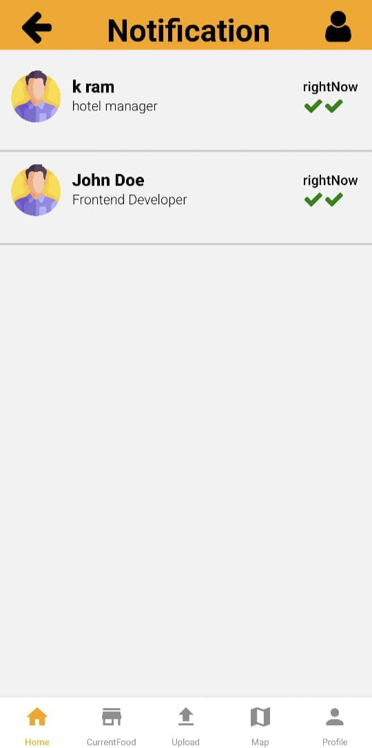
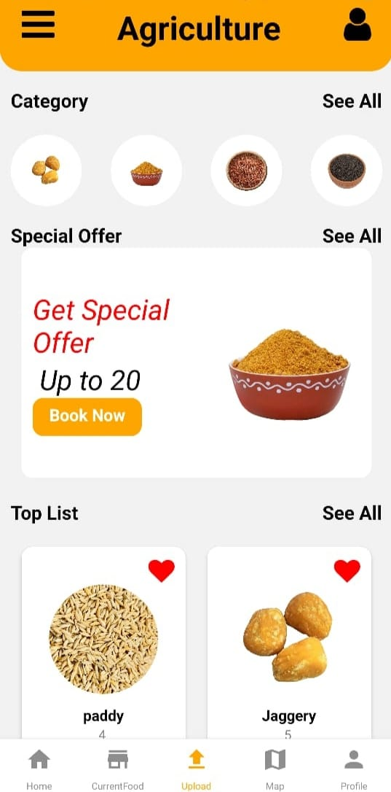

Slide 12
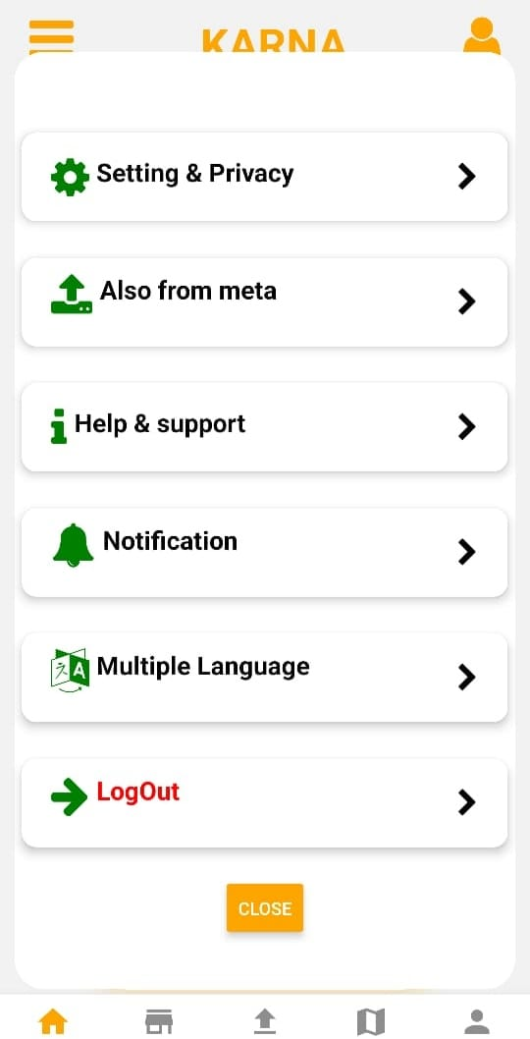
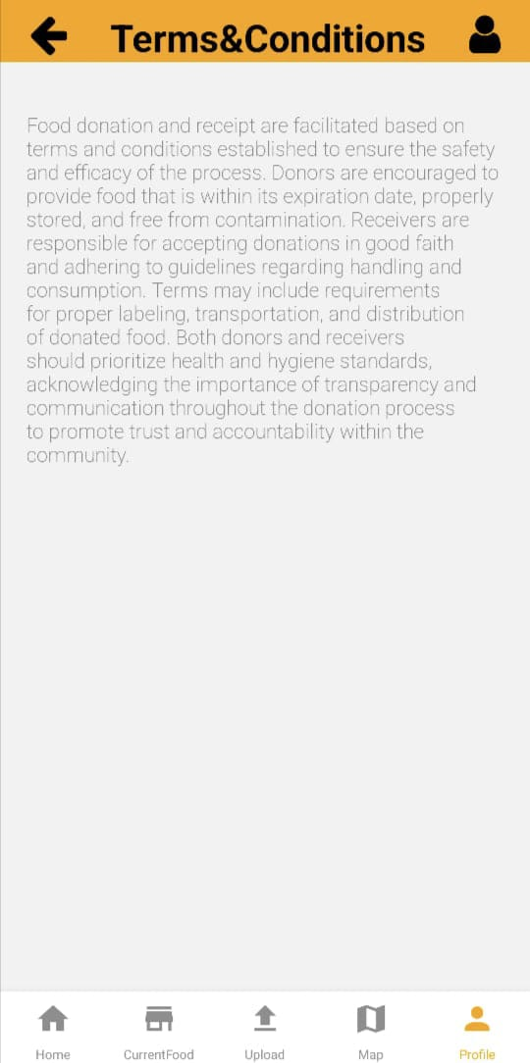

Slide 13
CONCLUSION
A waste food collection and delivery app can play a crucial role in addressing both food wastage and the needs of underprivileged individuals.
By connecting surplus food from restaurants, events, or households with those who are in need, the app promotes sustainability and social responsibility.
This initiative not only reduces food waste but also contributes to alleviating hunger and fostering a sense of community by channeling resources to where they are most needed.
Overall, such an app has the potential to make a positive impact on both the environment and society.

Slide 14
REFERENCE
Smith, J. (2020). "Global Food Disparities: A Comprehensive Analysis." Journal of Food Equity, 15(2), 123-145.
Johnson, M. (2018)."Technological Innovations in Food Distribution." Sustainable Technology Review, 7(4), 211-230.
Garcia, A., & Patel, S. (2019). "Community-Driven Solutions for Food Insecurity." Community Development Journal, 25(3), 178-195.
Green, R. (2021). "Governmental Policies and Food Accessibility." Policy Studies Review, 12(1), 45-67.
Chen, X., & Wang, L. (2017). "Blockchain in Food Supply Chain: A Comprehensive Review." International Journal of Information Management, 35(2), 324-335.

Slide 15
THANK YOU

